Slide 1

My Growth Since Starting College

Slide 2

Prepared Then
No short goals
No motivation
Bad attendance

Slide 3

Prepared NOW
Short term goals ( i.e getting to class on time, getting better sleep ect.)
Long term goals ( i.e graduating, finding a career)
Better motivation
Perfect attendance currently

Slide 4

Organized For this quarter
Not working/full time student
Better note taking skills
Never tardy

Slide 5

Organizing for the next quarter
Improving not taking skills

Slide 6

Work This quarter
Do schoolwork at school
Do schoolwork as soon as possible
Invest an hour a day to study
Initiative to practice

Slide 7
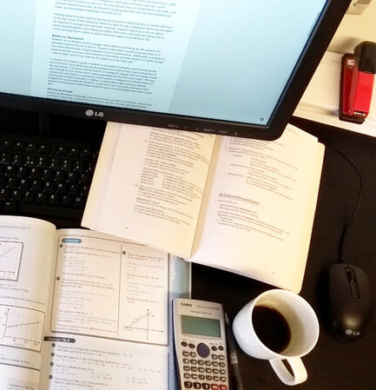
Work next quarter
Do unfinished schoolwork as soon as I get home
Invest an extra hour or two in studying
Continue having initiative to practice

Slide 8

Evaluating myself before ITI
No confidence
No motivation
A lot of anxiety
A lot of stress
Didn’t see much importance in the material
Didn’t value my classes

Slide 9

Evaluating myself during ITI
Better confidence
More motivation
Less Anxiety
Much less stress
Sees importance of material
Values classes more

Slide 10

Rethink
Networking
Or Programming
Have more of an IT mindset
Be more effective when helping family or friends

Slide 11


Who I am Then Vs. Now
Then
Now
Not confident
Not motivated
Anxiety ridden
More confident
Way more motivated
Less anxiety

